Slide 1

TINHVAN SOFTWARE
Unique propositions

Slide 2
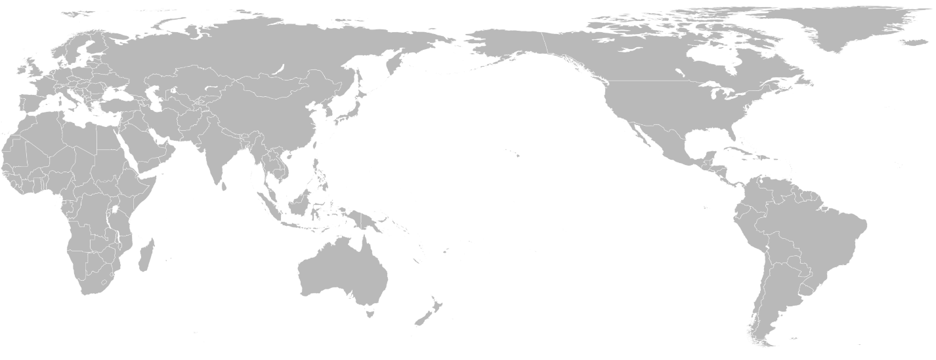

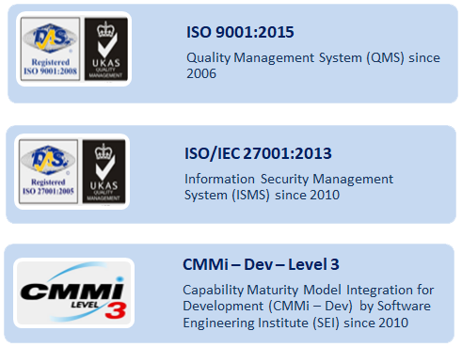
Tinhvan Software (TSO)
Who we are
TSO is a trustworthy partner in the global IT outsourcing market. Our rich and proven working experiences and technology expertise can meet the demands and standards of customers in diversified fields around the world.
TSO’s Unique Propositions
Education Software Development
QA Services
Blockchain /
Crypto
Data Science
E-commerce
Country: Vietnam (GMT+7)
Years of operation: 16
Employees: 250
Offices: Hanoi, Ho Chi Minh City, Tokyo
Website: http://tvo.vn
Current key markets: Vietnam, Japan, SEA, Germany
23

Slide 3











“Follow the sun” QA Services
Service Offerings
Our Strengths
1
Dedicated QA team working out of hours
1
Sizeable resource pool
Manual & automation testing in different environments.
CI/CD, automated testing & automation testing and
containerization are available with DevOps engineers.
Taking advantage of the time zone difference to build a non-stop development-testing cycle
2
Ability to ramp up team size fast
2
Overnight testing
Testing every night. Test results available in the next morning.
3
Mastering a variety of testing tools
3
Code review
High skilled QA service
4
Competitive price
Internal corporate development teams
Near-shore software outsourcing firms where this is a value-add.
US and European outsourcing/software companies
Potential partners

Slide 4






Case Studies
Testing team worked on hundred Panasonic projects over 8 years from around the world with approx. 30 Tinhvan testers.
Manual testing, automation testing, device testing, game testing.
Stress & load testing project for automotive vending machine for petroleum company to find the “system break point”.
Automation regression testing for Telkomsel - the biggest telco in South East Asia in terms of number of subscribers.
Testing team worked on various projects both onsite and remotely.
Beside testing as an integral part of any software development project, some case studies are highlighted for specialized testing work packages performed by TSO for customers.
Testing team worked on a multi-year project that requires domain knowledge and high proficiency in SQL.
TSO BA/testing team work remotely in an internationally-formed team in multiple time zones for rolling out a product for different countries in SEA.

Slide 5

Crypto/Blockchain
Service Offerings
Our Strengths
1
Dedicated team building crypto or blockchain products
1
Solid technical expertise
Vietnam is a hotspot in the blockchain world.
Why don’t tap its human resource pool?
Team members have developed crypto exchanges, crypto currencies and applications using blockchain-based public ledgers
Dedicated team building crypto or blockchain products
2
Team extension, adding crypto, blockchain expertise
2
Domain expertise
Blockchain Application Development
Crypto Wallet
Decentralize Finance Application
CeDeFi (Centralize – Decentralize Finance)
Smart Contract development & Auditing
GameFi (Game Finance)
NFT Development
Cryptocurrency Project Development and Management
White Papers
Pitch Decks
Intro Web
Fundraising, ICOs
Startups building crypto or blockchain offerings
Software development teams lacking crypto/blockchain talent
Crypto, blockchain vendors seeking audits
Outsourcing companies in US
Gaming companies that want to build games on blockchain (GameFi)
Potential partners

Slide 6




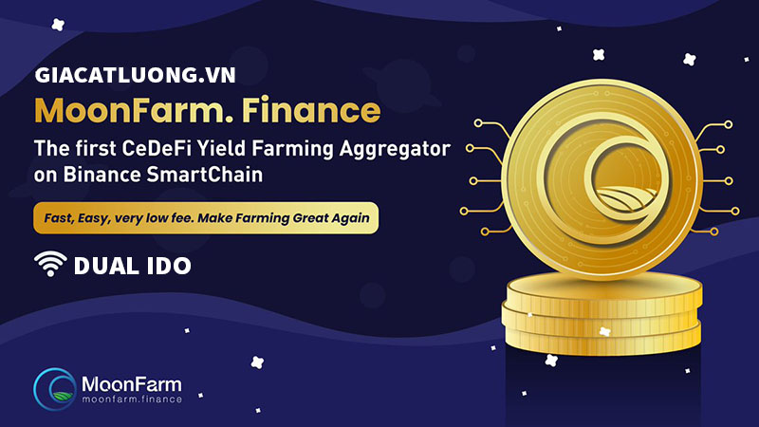
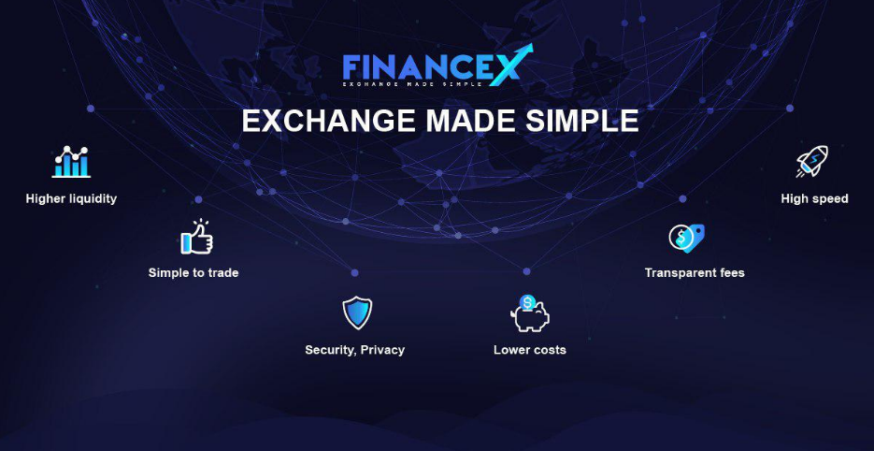
Case Studies
GameFi
CeDeFi
Coins trading platform
A blockchain-based role-play shooting game with a collection of weapons for players to equip, upgrade level to complete mission and earn NFT & tokens.
A CeDeFi platform that offers market leading yield farming optimization. By doing so, we will contribute to Bridge the gap between CeFi and DeFi; Remove entry barriers to yield farming and enhance users’ experience; Provide better capital utilization; Create strong optimization that provides the best benefits to DeFi users; Boost crypto adoption
FinanceX is a global digital asset trading platform with global fiat systems. FinanceX allows users to use local currency (fiat) from different countries such as Vietnam, Laos, Thailand, Indonesia, Myanmar for transactions.
· Project Name: FinanceX · Token code: FNX · Headquarters: Bugis Cube, Singapore · Foundation: Blockchain Ethereum ERC-20 standard · Total token sales: 495,000,000 FNX · Payment accepted by: BTC, ETH

Slide 7









Data Science
Service Offerings
Our Strengths
1
Part-time or full-time projects with data science, machine learning, artificial intelligence expertise
1
Talent availability
Leveraging research from top universities in Vietnam to address your data science issues
Access to 25 data scientists, with deep expertise in Machine Learning, Big Data Analysis, Artificial Intelligence, Machine translation,
6 professors with PhD degrees from US and Korean universities and 15+ PhD Students
Tools used: Tensor Flow, ML, AI, NL, etc.
CASE STUDIES
Analyzed and aggregated data from multiple sources and developed a data model that correlates the ordered and actually consumed fuel in flights with their assigned captains. An administrative decision, based on the findings of this analytics, has resulted in cutting down a half of ton of excessive fuel ordered per flight on average.
Potential partners
Corporate markets
Software companies
Software outsourcing firms

Slide 8

E-commerce
Service Offerings
Our Strengths
1
Develop complex e-commerce projects
1
Experienced developers/QA
Industry-leading back end expertise for e-commerce development
Experience with complex, real-time back-end integrations
Back-end development teams experienced in the most complex, real-time, e-commerce projects
2
Abilities to solve technical challenges
2
Team extensions to take backend development
Cloud to cloud
High traffic at peak hours/events
Connect to banking APIs, payment gateways, single sign-on
Potential partners
Marketing agencies focusing on the front-end and UX who have clients with complex back-end needs

Slide 9
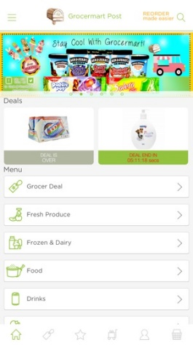
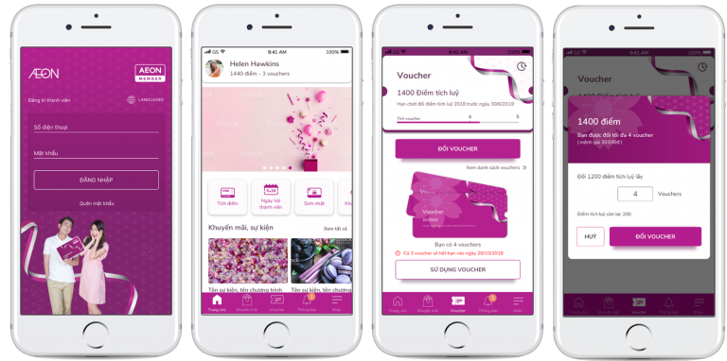
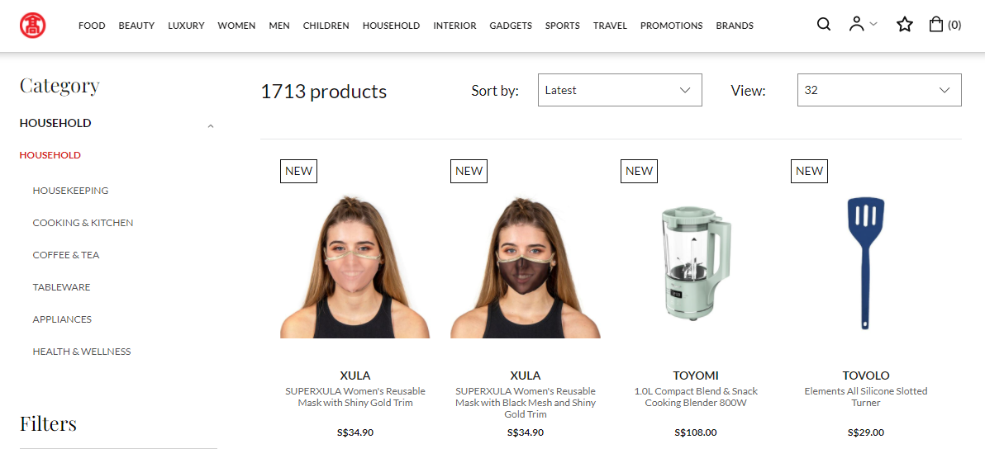
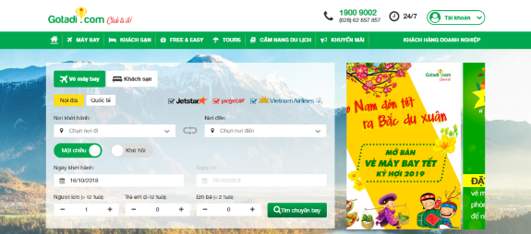

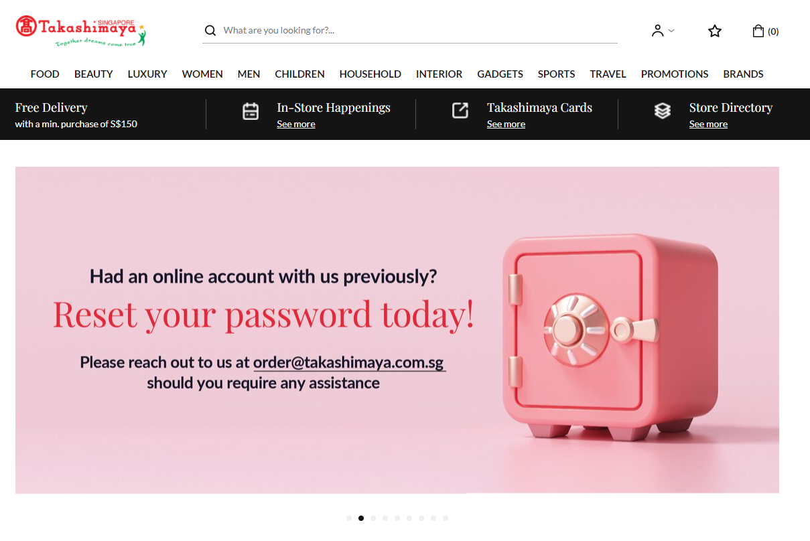
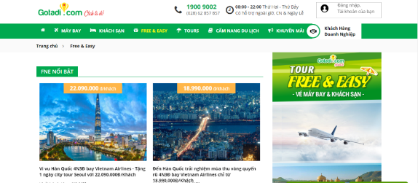
Case Studies
GROCEMART
AEON Loyalty App
GOTADI
Takashimaya
E-Commerce Platform
Mobile/E-Commerce Platform
Travel Booking Platform
E-Commerce Platform
An e-fulfillment Center for Business in Supply Chain to provide a platform for Omni Channel Retailing consisting of Webpage, Online Platform, and Mobile Application.
A Loyalty mobile app system where customers can search and buy products online from AEON. Customers can also search for events, using accumulate points for gift exchange etc.
An online air ticket, hotel and tour booking system integrated with travel information for Vietnamese tourists.
An e-commerce website of Takashimaya a well-known company in Japan with more than 180 years of development history in the business of high-end shopping malls
Description
Technical challenges
Real-time delivery tracking
B2B complex portal
300 merchants, providers, 40 thousands SKU
High Traffic Mobile Solution
Integrated/synced with Core-Retail
Integrate with 10 payment gateways, e-wallets, etc.
Manage 30K SKU
Real-time integration with Flight & Hotel booking systems
High Traffic UGC portal
Vast customization ecommerce portal based on Magento.
Integrate with many 3rd parties: inventory, delivery, payment gateway
Very complex portal

Slide 10


Education Software Development
Service Offerings
Our Strengths
1
A dedicated team for developing educational software and contents
1
Domain knowledge
In education domain, we are not only a software company, we are also a team of experts.
10+ experts with deep knowledge in developing educational software for K12, enterprise learning & testing platform, MOOC, integrated library system, educational content creation and digital publishing.
Fixed price or fixed monthly price - developing educational software products.
2
Team extension
2
Development workforce
Increase your velocity by adding more resources to work with your team.
25 developers & testers with mass experiences in implementing educational products & projects.
3
Valued money for high quality
3
Competitive price
Educational software developing companies
Edtech startups and companies
Outsourcing companies in US in education field
Potential partners

Slide 11












Case Studies
Vietnam nationwide online testing for K12 student to test their skills themselves
E-learning solution implemented for dozen universities, schools and enterprises
Full-fledged e-testing solutions that support both on site and online testing models
Digital publishing platform developed for publishers
Digital textbooks and ebook store with more than 250,000 registered users
Electronic Library Solution developed for hundred libraries
100,000+ JPY
Educational platform consist of specific tablet for children, tailor made contents, mobile apps for parent plan their kids’ learning path
Managerial software for public schools in California.
Admission and Enrollment portal for a University
Mobile app powered by advanced voice recognition technology for practicing English speaking skills.
Converting thousands of educational contents (K12) from Flash to HTML5
Extracting and indexing metadata from multiple Elsevier’s CD-based journal articles databases for integrated online search with other materials in library

Slide 12
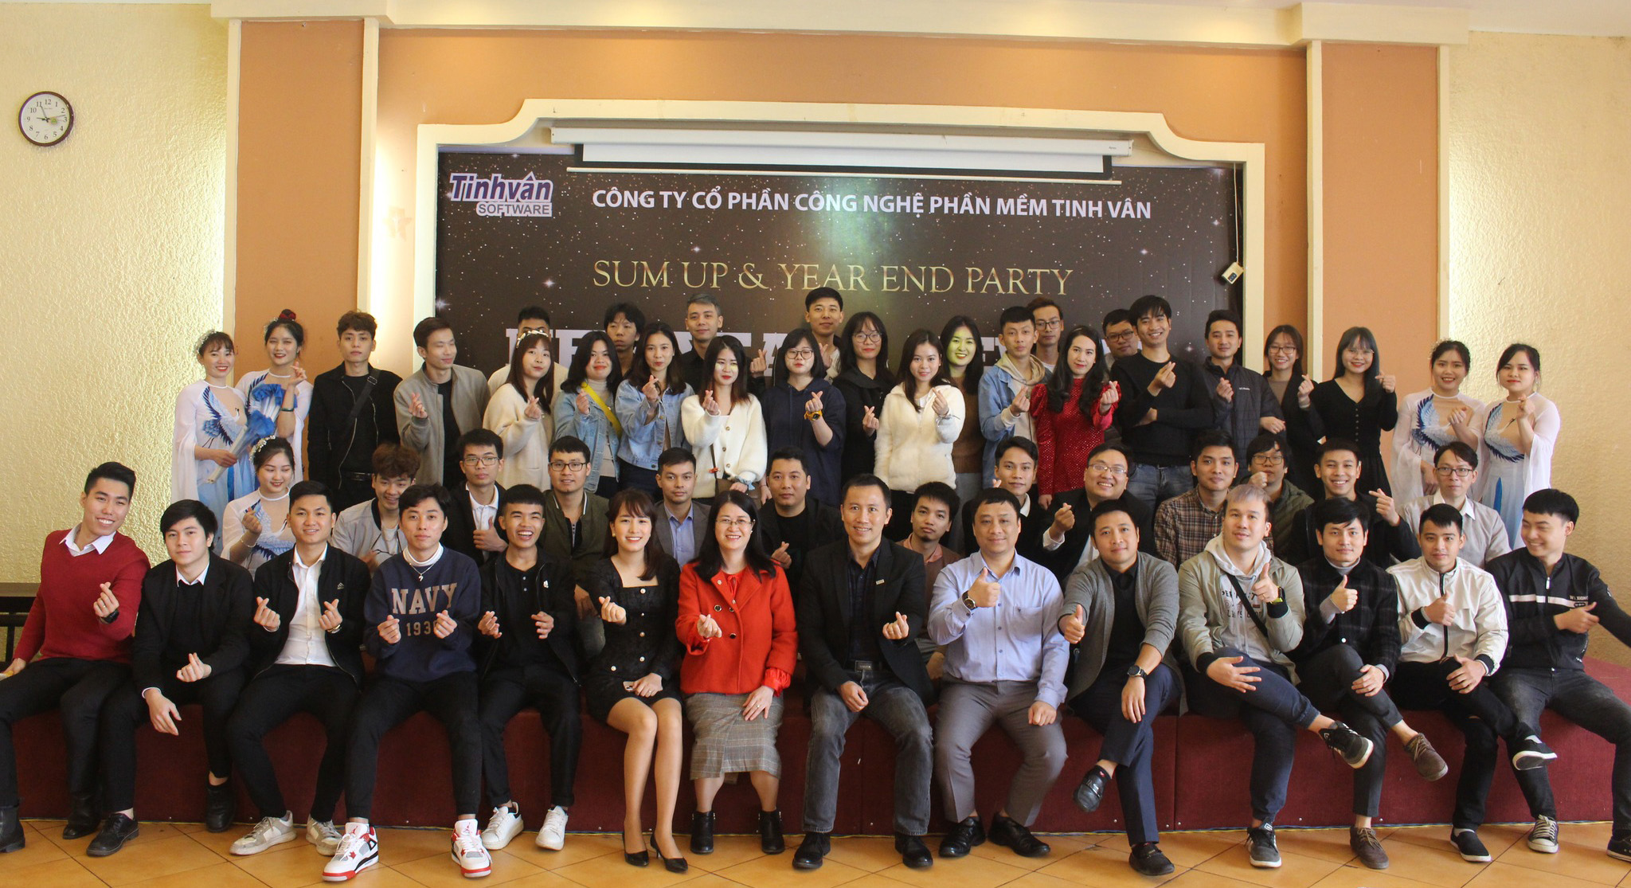
Our team can be yours. Thank you!

